Slide 1
.NET/C# Training
Parthiban
03/11/2023
Notes:
This template can be used as a starter file for presenting training materials in a group setting.
Sections
Right-click on a slide to add sections. Sections can help to organize your slides or facilitate collaboration between multiple authors.
Notes
Use the Notes section for delivery notes or to provide additional details for the audience. View these notes in Presentation View during your presentation.
Keep in mind the font size (important for accessibility, visibility, videotaping, and online production)
Coordinated colors
Pay particular attention to the graphs, charts, and text boxes.
Consider that attendees will print in black and white or grayscale. Run a test print to make sure your colors work when printed in pure black and white and grayscale.
Graphics, tables, and graphs
Keep it simple: If possible, use consistent, non-distracting styles and colors.
Label all graphs and tables.

Slide 2
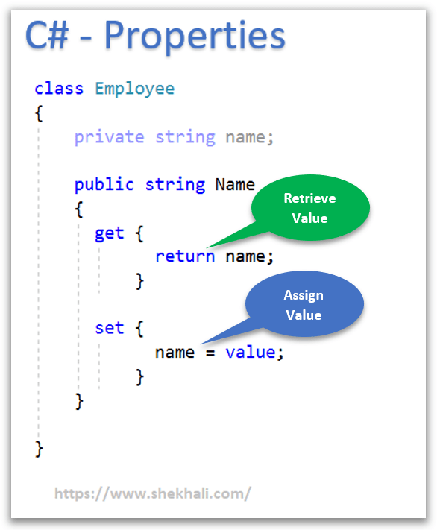
properties in C#
Notes:
Give a brief overview of the presentation. Describe the major focus of the presentation and why it is important.
Introduce each of the major topics.
To provide a road map for the audience, you can repeat this Overview slide throughout the presentation, highlighting the particular topic you will discuss next.

Slide 3
properties in C#
C# Property Syntax
<Access Modifier> <Return Type> <Property Name>
{
get {
// get accessor
// return value
}
set {
// set accessor
// assign a new value
}
}
Notes:
Give a brief overview of the presentation. Describe the major focus of the presentation and why it is important.
Introduce each of the major topics.
To provide a road map for the audience, you can repeat this Overview slide throughout the presentation, highlighting the particular topic you will discuss next.

Slide 4
public decimal Balance
{
get
{
return balance; // Get the current balance
}
set
{
if (value < 0)
{
// Don't allow negative balances
Console.WriteLine("Error: Balance cannot be negative.");
}
else
{
balance = value; // Set the balance if it's non-negative
}
}
}

Slide 5
UserName == "admin" && Password == "password@123"
true
true
&&
true
If(true){}
Else
{
}

Slide 6
Auto Implemented Properties in C#
No Explicit Field: With auto-implemented properties, you don’t need to declare an explicit private field to store the property’s value. The compiler generates an anonymous backing/private field for you.
Simplified Syntax: Auto-implemented properties use a simplified syntax, reducing the amount of code you need to write compared to traditional properties with explicit backing fields.
// Auto Implemented Property
public string Name { get; set; }

Slide 7
Fields: Fields are variables that can be directly declared within a class or struct. They are typically kept as private members of a class, allowing access through public get and set properties. Fields are essential for data encapsulation, which is a fundamental principle in Object-Oriented design.
Properties: In C#, a property is a class member that offers a versatile way to read, write, or compute data from a private field. Properties introduce a level of abstraction, enabling us to modify the field’s value without impacting how it’s used within a class.

Slide 8
IF Statement
if (condition)
{
// block of code to be executed if the condition is True
}
else
{
// block of code to be executed if the condition is False
}
int time = 20;
if (time < 18)
{
Console.WriteLine("Good day.");
}
else
{
Console.WriteLine("Good evening.");
}
// Outputs "Good evening."
Notes:
Give a brief overview of the presentation. Describe the major focus of the presentation and why it is important.
Introduce each of the major topics.
To provide a road map for the audience, you can repeat this Overview slide throughout the presentation, highlighting the particular topic you will discuss next.

Slide 9
using System;
namespace Conditional
{
class IfStatement
{
public static void Main(string[] args)
{
int number = 2;
if (number < 5)
{
Console.WriteLine("{0} is less than 5", number);
}
Console.WriteLine("This statement is always executed.");
}
}
}

Slide 10
if (boolean-expression)
{
// statements executed if boolean-expression is true
}
else
{
// statements executed if boolean-expression is false
}
if (number < 5)
{
number += 5;
}
else
{
number -= 5;
}

Slide 11
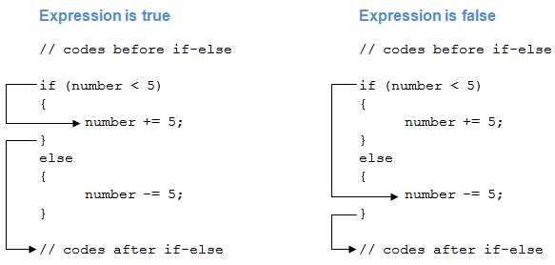
number = 4
number = 6

Slide 12
public static void Main(string[] args)
{
int number = 12;
if (number < 5)
{
Console.WriteLine("{0} is less than 5", number);
}
else
{
Console.WriteLine("{0} is greater than or equal to 5", number);
}
Console.WriteLine("This statement is always executed.");
}

Slide 13
if (boolean-expression-1)
{
// statements executed if boolean-expression-1 is true
}
else if (boolean-expression-2)
{
// statements executed if boolean-expression-2 is true
}
else if (boolean-expression-3)
{
// statements executed if boolean-expression-3 is true
}
.
.
.
else
{
// statements executed if all above expressions are false
}

Slide 14
if (condition1)
{
// block of code to be executed if condition1 is True
}
else if (condition2)
{
// block of code to be executed if the condition1 is false and condition2 is True
}
else
{
// block of code to be executed if the condition1 is false and condition2 is False
}

Slide 15
public static void Main(string[] args)
{
int number = 12;
if (number < 5)
{
Console.WriteLine("{0} is less than 5", number);
}
else if (number > 5)
{
Console.WriteLine("{0} is greater than 5", number);
}
else
{
Console.WriteLine("{0} is equal to 5");
}
}

Slide 16
public static void Main(string[] args)
{
int number = 12;
if (number < 5)
{
Console.WriteLine("{0} is less than 5", number);
}
else if (number > 5)
{
Console.WriteLine("{0} is greater than 5", number);
}
else
{
Console.WriteLine("{0} is equal to 5");
}
}

Slide 17
if (boolean-expression)
{
if (nested-expression-1)
{
// code to be executed
}
else
{
// code to be executed
}
}
else
{
if (nested-expression-2)
{
// code to be executed
}
else
{
// code to be executed
}
}

Slide 18
int time = 22;
if (time < 10)
{
Console.WriteLine("Good morning.");
}
else if (time < 20)
{
Console.WriteLine("Good day.");
}
else
{
Console.WriteLine("Good evening.");
}
// Outputs "Good evening."

Slide 19
C# Switch Statements
switch(expression)
{
case x:
// code block
break;
case y:
// code block
break;
default:
// code block
break;
}
Switch(<Expression>)
{
Case <Value> :
<stmts>
Break;
-----------------------
-------------------------
------------------------
Default :
<stmts>
Break;
}

Slide 20
Switch
int day = 4;
switch (day)
{
case 1:
Console.WriteLine("Monday");
break;
case 2:
Console.WriteLine("Tuesday");
break;
case 3:
Console.WriteLine("Wednesday");
break;
case 4:
Console.WriteLine("Thursday");
break;
case 5:
Console.WriteLine("Friday");
break;
case 6:
Console.WriteLine("Saturday");
break;
case 7:
Console.WriteLine("Sunday");
break;
}
// Outputs "Thursday" (day 4)

Slide 21
Switch
int day = 4;
switch (day)
{
case 6:
Console.WriteLine("Today is Saturday.");
break;
case 7:
Console.WriteLine("Today is Sunday.");
break;
default:
Console.WriteLine("Looking forward to the Weekend.");
break;
}
// Outputs "Looking forward to the Weekend."

Slide 22
char ch;
Console.WriteLine("Enter an alphabet");
ch = Convert.ToChar(Console.ReadLine());
switch(Char.ToLower(ch))
{
case 'a':
Console.WriteLine("Vowel");
break;
case 'e':
Console.WriteLine("Vowel");
break;
case 'i':
Console.WriteLine("Vowel");
break;
case 'o':
Console.WriteLine("Vowel");
break;
case 'u':
Console.WriteLine("Vowel");
break;
default:
Console.WriteLine("Not a vowel");
break;
}

Slide 23
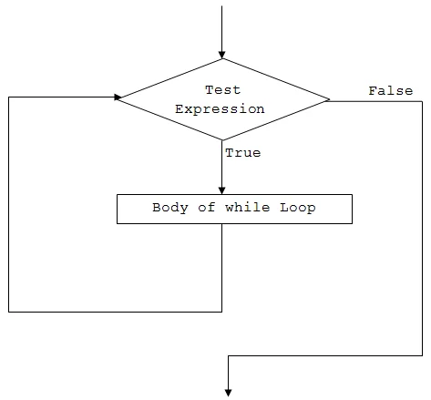
While Loop
Loops can execute a block of code as long as a specified condition is reached.
while (condition)
{
// code block to be executed
}
int i = 0;
while (i < 5)
{
Console.WriteLine(i);
i++;
}

Slide 24
int i = 0;
while (i < 2)
{
Console.WriteLine(i);
i++;
}
 | i Initial Value 0 | New Value (i++) | Condition i<2 | Result
1 iteration | 0 | 1 | 0<2 | true
2nd iteration | 1 | 2 | 1<2 | true
3rd iteraation | 2 |  | 2<2 | false

Slide 25
int i = 2;
while (i <=4 )
{
Console.WriteLine(i);
i++;
}
 | i Initial Value 2 | New Value (i++) | Condition i<2 | Result
1 iteration | 2 | 3 | 2<=4 | true
2nd iteration | 3 | 4 | 3<=4 | true
3rd iteration | 4 | 5 | 4<=4 | true
4th iteration | 5 |  | 5<=4 | false

Slide 26
While Loop
do
{
// code block to be executed
}
while (condition);
int i = 0;
do
{
Console.WriteLine(i);
i++;
}
while (i < 5);

Slide 27
For Loop
for (statement 1; statement 2; statement 3)
{
// code block to be executed
}
Statement 1 is executed (one time) before the execution of the code block.
Statement 2 defines the condition for executing the code block.
Statement 3 is executed (every time) after the code block has been executed.
for (initialization; condition; iterator)
{
// body of for loop
}
for (int i = 0; i < 5; i++)
{
Console.WriteLine(i);
}

Slide 28
for (int i = 0; i < 2; i++)
{
Console.WriteLine(i);
}
 | i Initial Value 0 | New Value (i++) | Condition i<2 | Result
1 iteration | 0 | 1 | 0<2 | true
2nd iteration | 1 | 2 | 1<2 | true
3rd iteration |  |  | 2<2 | false

Slide 29
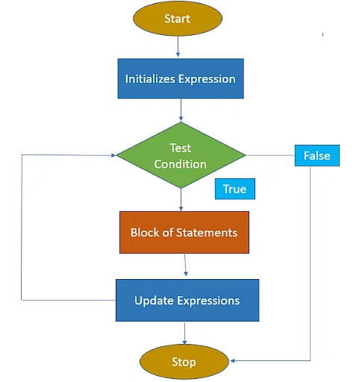
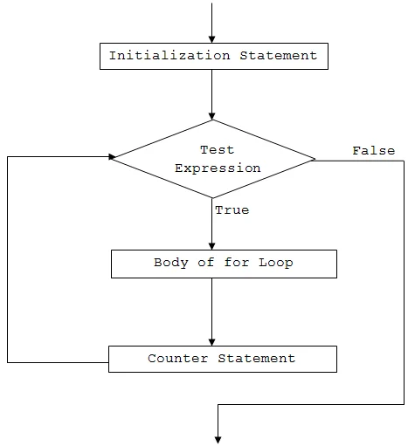

Slide 30
C# Break and Continue
for (int i = 0; i < 10; i++)
{
if (i == 4)
{
break;
}
Console.WriteLine(i);
}
The break statement can also be used to jump out of a loop.
for (int i = 0; i < 10; i++)
{
if (i == 4)
{
continue;
}
Console.WriteLine(i);
}

Slide 31
C# Arrays
Arrays are used to store multiple values in a single variable, instead of declaring separate variables for each value.
string[] cars;
string[] cars = {"Volvo", "BMW", "Ford", "Mazda"};
Access the Elements of an Array
Volvo | BMW | Ford | Mazda
0 | 1 | 2 | 3
string[] cars = {"Volvo", "BMW", "Ford", "Mazda"};
Console.WriteLine(cars[0]);
// Outputs Volvo

Slide 32
Change an Array Element
string[] cars = {"Volvo", "BMW", "Ford", "Mazda"};
cars[0] = "Opel";
Console.WriteLine(cars[0]);
// Now outputs Opel instead of Volvo
Array Length
string[] cars = {"Volvo", "BMW", "Ford", "Mazda"};
Console.WriteLine(cars.Length);
// Outputs 4

Slide 33
string[] cars = new string[4];
// Create an array of four elements and add values right away
string[] cars = new string[4] {"Volvo", "BMW", "Ford", "Mazda"};
// Create an array of four elements without specifying the size
string[] cars = new string[] {"Volvo", "BMW", "Ford", "Mazda"};
// Create an array of four elements, omitting the new keyword, and without specifying the size
string[] cars = {"Volvo", "BMW", "Ford", "Mazda"};
// Declare an array
string[] cars;
// Add values, using new
cars = new string[] {"Volvo", "BMW", "Ford"};
// Add values without using new (this will cause an error)
cars = {"Volvo", "BMW", "Ford"};

Slide 34
Loop Through an Array
string[] cars = {"Volvo", "BMW", "Ford", "Mazda"};
for (int i = 0; i < cars.Length; i++)
{
Console.WriteLine(cars[i]);
}
The foreach Loop
foreach (type variableName in arrayName)
{
// code block to be executed
}
string[] cars = {"Volvo", "BMW", "Ford", "Mazda"};
foreach (string i in cars)
{
Console.WriteLine(i);
}

Slide 35
Sort an Array
// Sort a string
string[] cars = {"Volvo", "BMW", "Ford", "Mazda"};
Array.Sort(cars);
foreach (string i in cars)
{
Console.WriteLine(i);
}
result
// Sort an int
int[] myNumbers = {5, 1, 8, 9};
Array.Sort(myNumbers);
foreach (int i in myNumbers)
{
Console.WriteLine(i);
}

Slide 36
HR Management
GetSalary(string emptype)
Tax Calculation

